Slide 1
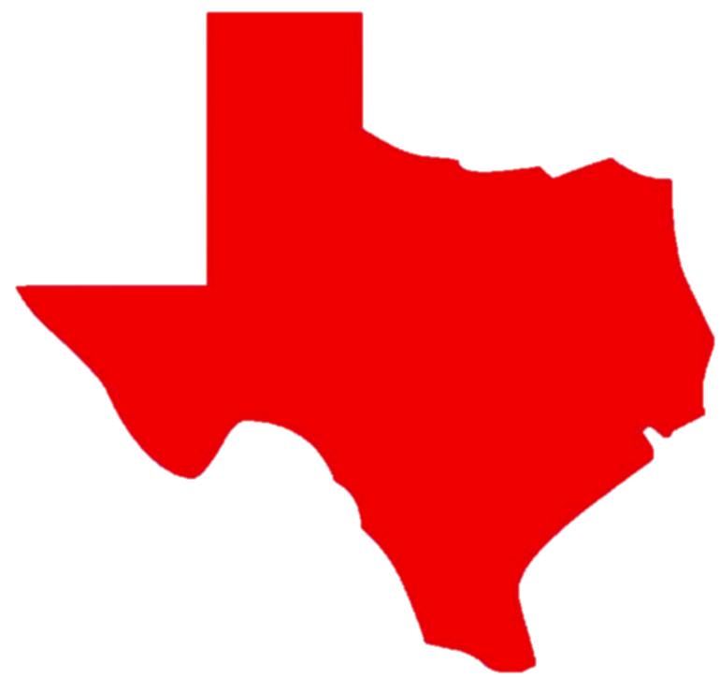
AAAA Insurance Overview
AAAA Insurance
8-May 2020
Update 0.1

Slide 2
About Us
AAAA Insurance has been In business since 1994—strong name brand recognition and reputation in industry
One of the fastest growing insurance companies in TX—50% growth in the last 4 yrs
Duality—ability to serve the non-standard (high risk) as well as standard markets
Multitude of products—Auto, Home, Renters, Commercial, General Liability, Tax, and much more
Own-branded insurance product since 2007 (longest of any TX insurance carrier)
Concentrated in greater Houston area, San Antonio, Austin, and Dallas/Fort Worth
Strong partnerships with insurance carriers—representing over 30 companies
Tier1 support amongst key partners to facilitate identifying right product for customers
Dedicated in-house underwriting and claims department
Notes:
We are the one of the fastest growing insurance company serving the non-standard market in Texas. We are currently concentrated Austin, San Antonio, Houston, El Paso, and DFW with more than 210 locations and counting. We are seeking candidates looking for the next big challenge in the non-standard market. Most of our locations offer common products & services such as auto and home insurance, business insurance, general liability, motorcycle insurance, renters insurance, and much more. Our growth and success is tied to keeping our margins low and passing that savings on to our customers. We have a vested interest in keeping our customers insured and safe.

Slide 3
Company History
Motto: Customer Service is our #1 Priority
Earning trust one customer at a time
Small company benefits with a big corporation backing
2019 20th location established
2014—16th location
2010—in-house support established
2007—AAAA product appointment
2003—representation from 30 companies
2000—opening of 10th location
1996—appointed for commercial products
1994—1st location in SW Houston
From the formation of the 1st location nearly 30 years ago, AAAA has prided itself in conducting business ethically
Notes:
We are the one of the fastest growing insurance company serving the non-standard market in Texas. We are currently concentrated Austin, San Antonio, Houston, El Paso, and DFW with more than 210 locations and counting. We are seeking candidates looking for the next big challenge in the non-standard market. Most of our locations offer common products & services such as auto and home insurance, business insurance, general liability, motorcycle insurance, renters insurance, and much more. Our growth and success is tied to keeping our margins low and passing that savings on to our customers. We have a vested interest in keeping our customers insured and safe.

Slide 4
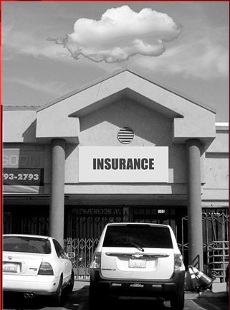
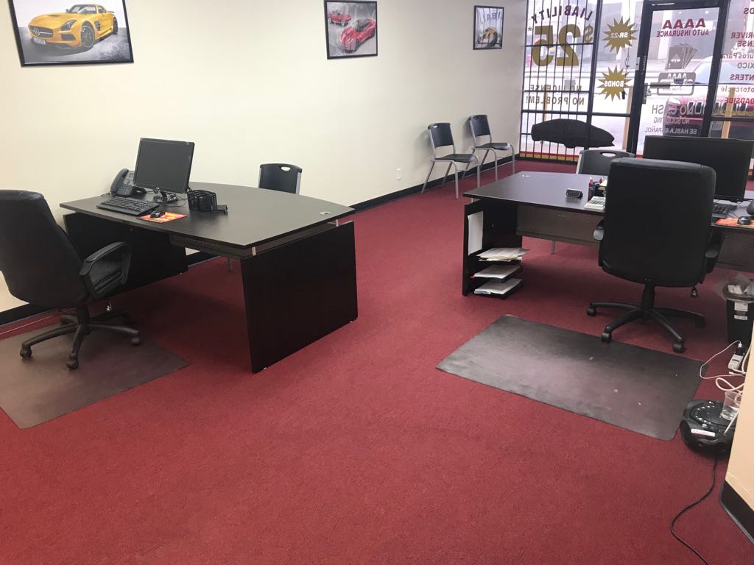
AAAA Offices vs. Independent Agencies
VS.
Name Brand Recognition!

Slide 5
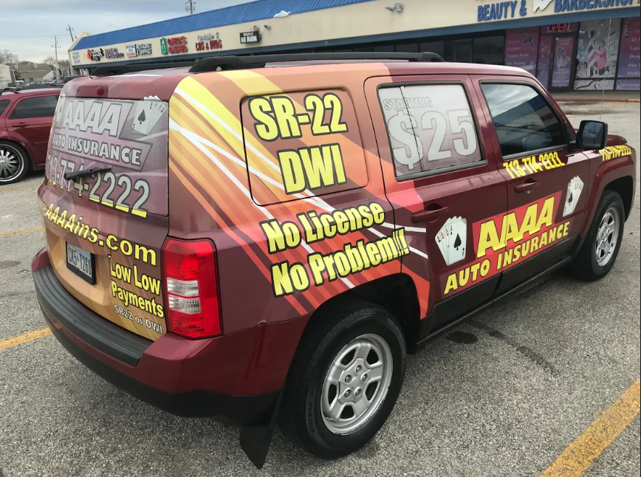
National Marketing Campaigns
Marketing Influence—Household Name

Slide 6
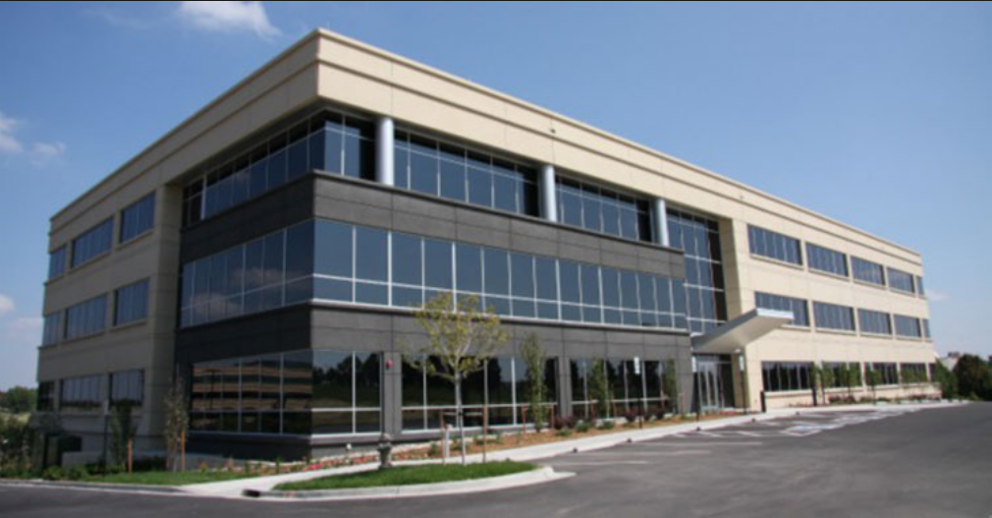
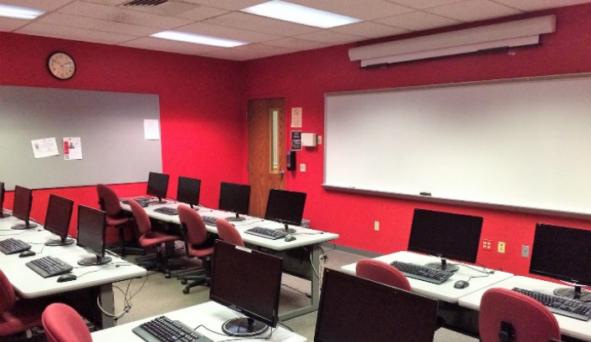
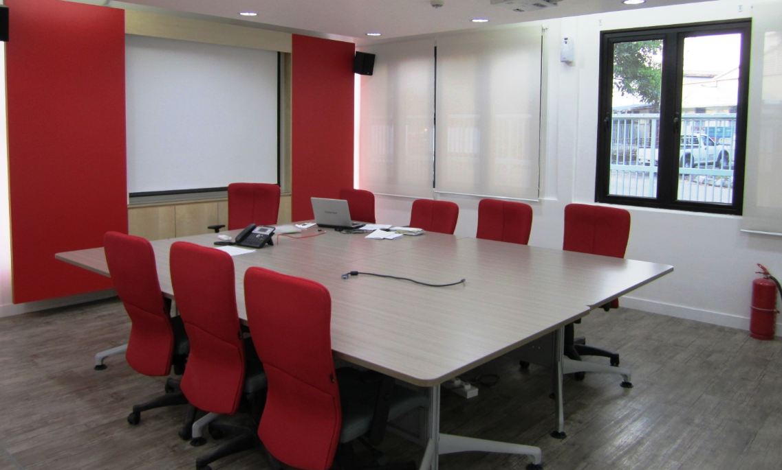
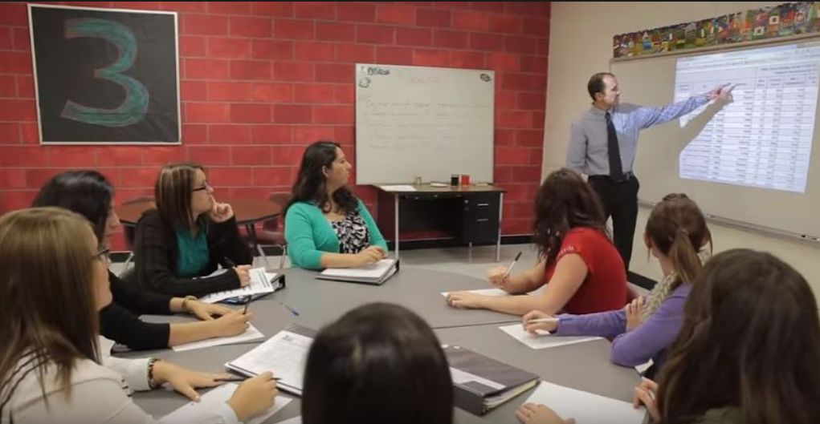
Corporate Headquarters—Houston, TX
Corporate Training & Support
Accounting and Underwriting
New Franchisee onboarding
Strong Training and Support for Success

Slide 7
What Customers are Saying About AAAA
Jennifer Colores
Local Guide ・42 reviews
★★★★★ a year ago
Staff is friendly and looks for ways to help you.
bearded as fluck
11 reviews
★★★★★ a month ago
Tammys great! Affordable insurance with no hassle.
SUSIE MILLER
4 reviews
★★★★★ a year ago
Been with them for over 5 years! After Harvey , they took care of my claim within two weeks ! Not only that , my policy just renews and I got a lower rate! Im glad I found AAAA when I was shopping around.
Kamin Ervin
Local Guide ・39 reviews・3 photos
★★★★★ 11 months ago
Great price and very nice ppl
Carolina Herrera
4 reviews
★★★★★ a year ago
after shopping around for the last month these guys were the cheapest out there, and their service was WAY BETTER then my past carrier for FIVE YEARS!!. I wouldn't go anywhere else. These guys know what they're doing. I've been with them for nearly 8 years and they've always had the best rates in town. don't take a chance, get your insurance from these agents. I specifically talked to Araceli and she was great help!
Ashley Gonzales
3 reviews
★★★★★ 9 months ago
My parents recently got insurance in this office and they had such a good experience they wanted me to leave a review for them. The ladies helping them were awesome so nice and bubbly my parents were greeted as soon as they walked in which made them feel welcome and comfortable. The ladies were so helpful and provided my parents with all the information they asked. I would be recommending this insurance office to everybody I know, thanks to the staff that went above and beyond to help my parents.
Rodney Arndt
1 review
★★★★★ a year ago
I spoke with Mel first thing this morning needing assistance with obtaining insurance for my 1978 F150. We were not able to get what I needed but Mel was persistent and worked on the issue for me and called me back within the hour with a very workable solution! She was very friendly and professional and she helped solve my problem. She provided excellent customer service! Thanks Mel.
Agustín Hernandez
1 review
★★★★★ 3 days ago
Atlai es un buen muchacho muy atento a su trabajo me ayudó con todo lo que necesitaba ni en ningún momento me quito la atención explicó todo muy claro y dejo entender todo estoy muy agradecido con su servicio y atención al cliente muchas gracias. Agustín
Customer Service is our #1 Priority

Slide 8
Insurance & Tax Industry
Auto insurance—nearly 200M policies nationwide
~80% sold by independent agents (like AAAA)
Auto insurance is REQUIRED BY LAW
Target demographics is Latino community—fastest growing demographic in the nation
Non-standard market prefers F2F sales and interaction in person—locations are key to success
Tax industry—nearly $20B industry (yes B as in Billion)
240M tax returns filed each year according to IRS
Target demographics-Latino community show tax return filings increasing at 5% annually
Latinos paid over $130B in federal taxes!!
Non-standard market represents in excess of 30% of the total market
Notes:
We are the one of the fastest growing insurance company serving the non-standard market in Texas. We are currently concentrated Austin, San Antonio, Houston, El Paso, and DFW with more than 210 locations and counting. We are seeking candidates looking for the next big challenge in the non-standard market. Most of our locations offer common products & services such as auto and home insurance, business insurance, general liability, motorcycle insurance, renters insurance, and much more. Our growth and success is tied to keeping our margins low and passing that savings on to our customers. We have a vested interest in keeping our customers insured and safe.

Slide 9
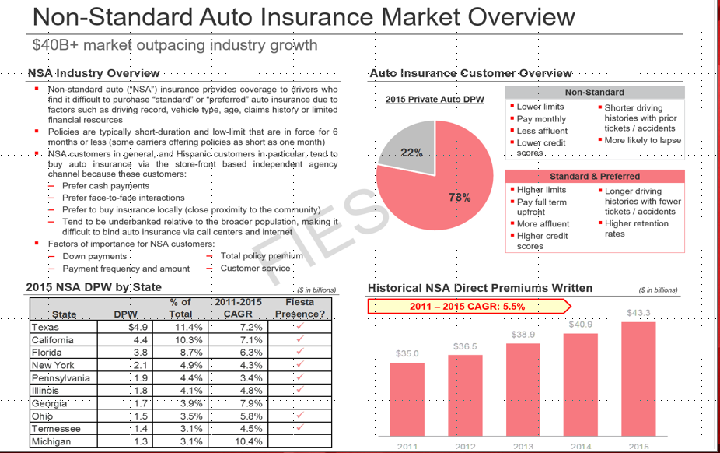
Non-Standard Insurance Market
Aaaa
Aaaa
Aaa
Products Offered
Auto | Roadside Assistance
Motorcycle | Mexico Insurance
Homeowners | AD&D/Life Insurance
Renters | Tax Preparation Service
Commercial | No License Insurance
General Liability | SR22 / DUI
Bonds | Boat/ATV
Campers/RV | Worker’s Compensation
Progressive (Standard)
Non Standard market is growing aggressively
Notes:
Bilingual - Spanish / English
Owner operator - work in the business everyday
Strong match on our personality assessment
Follow all the corporate training and support suggestions
Secure a great, visible location
Meet all financial requirements
Fiesta has opened more then 200 locations in 10 different States so we have that experience to share with you in the process of opening and operating your Fiesta franchise

Slide 10
AAAA Business Model
Perfect Blend of Products!
All locations have access to all of AAAA product selections
Non-standard insurance is one of the most resilient industries—little to no impact during the toughest recessions
Proven business model for the last 30 years with access to the best insurance carriers in the country
Ability to sell Standard products as well
Products Offered
Auto | Roadside Assistance
Motorcycle | Mexico Insurance
Homeowners | AD&D/Life Insurance
Renters | Tax Preparation Service
Commercial | No License Insurance
General Liability | SR22 / DUI
Bonds | Boat/ATV
Campers/RV | Worker’s Compensation
Progressive (Standard) | Telemedicine
Perfect Combination for Company Success!
Notes:
Bilingual - Spanish / English
Owner operator - work in the business everyday
Strong match on our personality assessment
Follow all the corporate training and support suggestions
Secure a great, visible location
Meet all financial requirements
Fiesta has opened more then 200 locations in 10 different States so we have that experience to share with you in the process of opening and operating your Fiesta franchise

Slide 11
AAAA Location Map
Corporate Locations
Locations established over 20 major cities across Texas
Dallas/Fort Worth
Growth Plans
2019 4 New locations
2020 3 New locations
2021 4 New locations
2022 9 New locations
20 locations by end of 2022
Coming soon
Amarillo
Lubbock
Fort Worth
Dallas
Abilene
Midland
Longview
El Paso
Waco
Tyler
Odessa
Killeen
Temple
Austin
Houston
San Antonio
Beaumont
Laredo
Victoria
Corpus Christi
McAllen
Brownsville
Pride in the Communities we Serve!

